Slide 1
Movements of GIT
Dr Reshmy K.R
HoD, Dept. of Physiology
SKHMC

Slide 3
Mastication
Cutting of food substances into small particles and grinding them into a soft bolus
First mechanical process to which food is subjected to.
An involuntary as well as reflex act

Slide 4
Chewing
A rhythmic movement brought about by lips, tongue, and jaw with teeth.
Lower jaw can move in all planes and it can rotate.
Movements of jaw is affected by contraction of the muscles of mastication

Slide 5
Muscles of mastication
Masseter
Temporalis
Pterygoids
Buccinators
All are voluntary muscles and the strongest muscles
A crushing force of 50-80kg can be generated on the molars during chewing

Slide 6
Movements during mastication
Centre for mastication –medulla, cerebral cortex
Chewing reflex influenced by higher centers –hypothalamus, reticular formation amygdala, cerebral cortex near the sensory area of taste causes movements similar to mastication.

Slide 7
Aim of mastication
Primary function of mastication is to facilitate deglutition or swallowing by reducing the size of food particles and lubricating them with saliva
Helps in digestion, chewing increases salivary , gastric and pancreatic secretion of cephalic phase.
Surface area of food particles is increased so that digestive enzymes can act more effectively
Chewing helps in appreciation of taste and gives pleasue of eating

Slide 8
Disturbance of chewing
Absence of teeth leads to indigestion
Paralysis of facial nerve leads to collection of saliva between teeth and cheek
Inability to chew is an early sign of myasthenia gravis

Slide 9
Mastication-significance
Breaking down of foodstuffs into smaller particles
Mixing of saliva with food substances
Lubrication & moistening of dry food by saliva
Appreciation of taste of food

Slide 10
muscles involved in movemets of mastication
masseter
temporal
pterygoids --mandibular division of V cranial nerve
buccinator

Slide 11
Movements of mastication
Closure &opening of mouth
Rotational movements of jaw
Protraction & retraction of jaw
Center for mastication situated in the medulla and cerebral cortex

Slide 12
Deglutition
Masticated food moves from mouth to stomach via pharynx and esophagus
3 stages
Oral stage
Pharyngeal stage
Esophageal stage

Slide 13
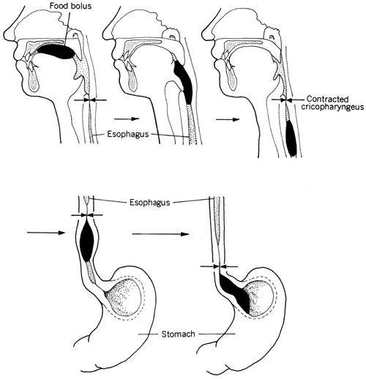
Stages of Deglutition

Slide 14
I.Oral stage
Passage of bolus through oral cavity into the pharynx.
Voluntary stage
Bolus is in the posterodorsal surface of the tongue-preparatory position
Front of the tongue is relaxed & depressed
Post. part of tongue is elevated & retracted against hard palate

Slide 15
Forceful contraction of the tongue against the palate produces a positive pressure in the post. part of oral cavity whch pushes the food into pharynx.

Slide 16
II.Pharyngeal stage/ IInd stage of deglutition
Involuntary stage
Bolus is pushed from Pharynx into theEesophagus

Slide 17
The entire pharyngeal stage of swallowing usually occurs in less than 6 seconds, thereby interrupting respiration for only a fraction of a usual respiratory cycle.
The swallowing center specifically inhibits the respiratory center of the medulla during this time, halting respiration at any point in its cycle to allow swallowing to proceed.

Slide 18
III.Esophageal Stage of Swallowing.
The esophagus functions primarily to conduct food rapidly from the pharynx to the stomach
The esophagus normally exhibits two types of peristaltic movements:
Primary peristalsis and Secondary peristalsis.
Primary peristalsis is simply continuation of the peristaltic wave that begins in the pharynx and spreads into the esophagus during the pharyngeal stage of swallowing.
pharynx to the stomach in about 8 to 10 seconds.

Slide 19
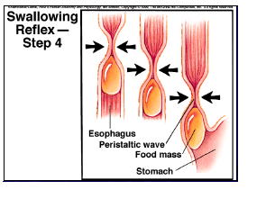

Slide 20
Food swallowed by a person who is in the upright position is usually transmitted to the lower end of the esophagus even more rapidly than the peristaltic wave itself, in about 5 to 8 seconds, because of the additional effect of gravity pulling the food

Slide 21
Secondary peristalsis
If the primary peristaltic wave fails to move into the stomach all the food that has entered the esophagus, secondary peristaltic waves result from distention of the esophagus itself by the retained food; these waves continue until all the food has emptied into the stomach.
The secondary peristaltic waves are initiated
partly by intrinsic neural circuits in the myenteric nervous system
partly by reflexes that begin in the pharynx and are then transmitted upward through vagal afferent fibers to the medulla and back again to the esophagus through glossopharyngeal and vagal efferent nerve

Slide 22
Movements of Stomach-Hunger contractions
When the stomach has been empty for several hours or more.
Rhythmical peristaltic contractions in the body of the stomach.
When the successive contractions become extremely strong, they often fuse to cause a continuing tetanic contraction that sometimes lasts for 2 to 3 minutes.

Slide 23
Hunger contractions are most intense in young, healthy people who have high degrees of gastrointestinal tonus.
Greatly increased by the person’s having lower than normal levels of blood sugar.
When hunger contractions occur in the stomach, the person sometimes experiences mild pain in the pit of the stomach, called hunger pangs.
Hunger pangs usually do not begin until 12 to 24 hours after the last ingestion of food.
In starvation, they reach their greatest intensity in 3 to 4 days.

Slide 24
Receptive Relaxation of the Stomach
When the esophageal peristaltic wave approaches toward the stomach, a wave of relaxation, transmitted through myenteric inhibitory neurons, precedes the peristalsis.
Furthermore, the entire stomach and, to a lesser extent, even the duodenum become relaxed as this wave reaches the lower end of the esophagus and thus are prepared ahead of time to receive the food propelled into the esophagus

Slide 26
Lower esophageal sphicter/Gastroesophageal Sphincter
At the lower end of the esophagus, extending upward about 3 centimeters above its juncture with the stomach, the esophageal circular muscle functions as a broad lower esophageal sphincter,
This sphincter normally remains tonically constricted

Slide 27
With an intraluminal pressure at this point in the esophagus of about 30 mm Hg, in contrast to the midportion of the esophagus, which normally remains relaxed.
When a peristaltic swallowing wave passes down the esophagus, there is “receptive relaxation” of the lower esophageal sphincter ahead of the peristaltic wave, which allows easy propulsion of the swallowed food into the stomach.
Rarely, the sphincter does not relax satisfactorily, resulting in a condition called achalasia.

Slide 28
Peristalsis of Stomach
A weak peristaltic constrictor waves, called mixing waves, begin in the mid to upper portions of the stomach wall and move toward the antrum about once every 15 to 20 seconds.
Initiated by the gut wall Basic Electrical Rhythm
Electrical “slow waves” that occur spontaneously in the stomach wall.

Slide 29
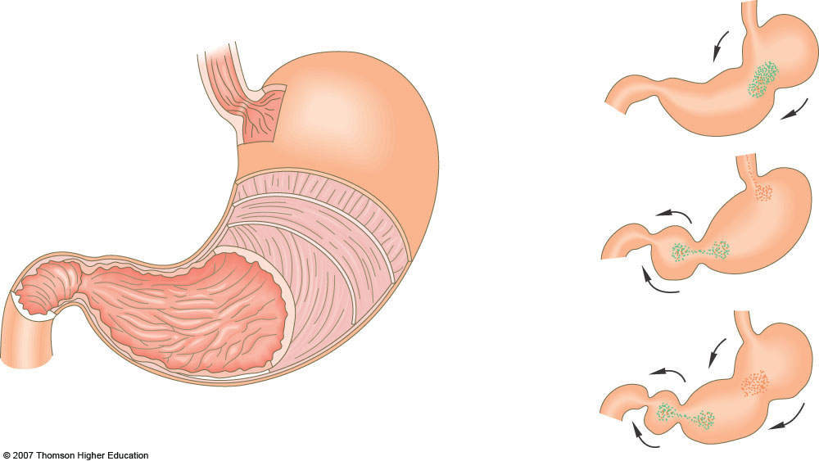
Peristaltic movement
esophagus
1
pyloric sphincter
2
3
duodenum
Fig. 7.6, p. 124
Notes:
Figure 7.6 Animated!(a) Structure of the stomach.(b) A peristaltic wave down the stomach, produced by alternating contraction and relaxation of muscles in the stomach wall.

Slide 30
As the constrictor waves progress from the body of the stomach into the antrum, they become more intense,
some becoming extremely intense and providing powerful peristaltic action potential–
driven constrictor rings that force the antral contents under higher and higher pressure toward the pylorus.
These constrictor rings also play an important role

Slide 31
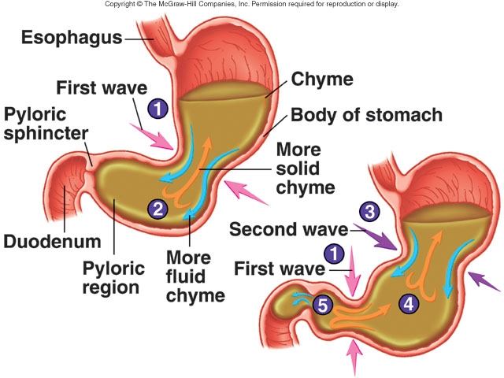

Slide 32
Formation of Chyme?
As each peristaltic wave approaches the pylorus, the pyloric muscle itself often contracts, which further impedes emptying through the pylorus.
Most of the antral contents are squeezed upstream though the peristaltic ring toward the body of the stomach.
Moving peristaltic constrictive ring, combined with this upstream squeezing action, called “retropulsion,” -mixing mechanism in the stomach.

Slide 33
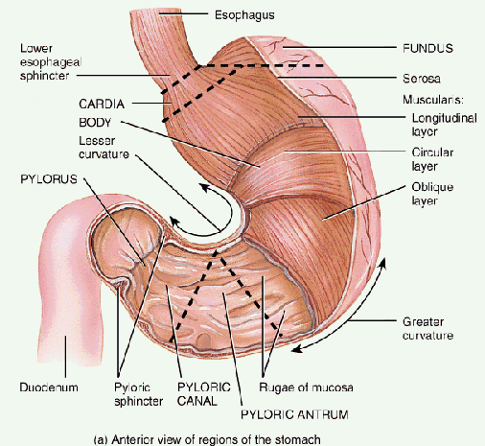
Emptying of the stomach (pyloric pump)
Peristalsis
+
relaxation of pyloric sphincter

Slide 34
Gastric Factors That Promote Emptying
Gastrin also has mild to moderate stimulatory effects on motor functions in the body of the stomach- enhance the activity of the pyloric pump.
Volume of gastric content
Consistency of gastric content
Chemical composition
pH of gastric content
Osmolar concentraction of gastric content

Slide 35
Stomach emptying
Gastric factors Duedenal factors Others
_ _ _ _ _
+ + + + +
1- chemicals
2- autonomic
Sympathetic and parasymp.)
3-emotions
4-consistency
&type of food
1- enterogastric
reflex
2- hormones :
Secretin, CCK
GIP, somatostatin
1- volume of gastric contents
2- gastrin hormone

Slide 36
Regulation of Stomach Emptying (inhibit emptying)
The rate at which the stomach empties is regulated by signals from both the stomach and the duodenum.
Inhibition of gastric motility( preventing emptying)
Nervous factors- Enterogastric reflex- inhibit the normal excitatory signals transmitted to the stomach through the vagi.
Presence of irritants and acids in the duodenal chyme
pH of the chyme in the duodenum falls below about 3.5 to 4, the reflexes frequently block further release of acidic chyme
Hormonal factors-Enterogastron, CCK, Secretin, GIP(glucose dependent insulinotropic peptide)

Slide 38
Movements of Small Intestine
I.Mixing movements, which keep the intestinal contents thoroughly mixed at all times.
II. Propulsive movements, which cause food to move forward along the tract at an appropriate rate to accommodate digestion and absorption.

Slide 39
To mix chyme with digestive secretion
To bring fresh chyme into contact with the absorptive surface of the microvili
To propel chyme toward the colon

Slide 40
I.Mixing movements
Segmentation contraction
Occur regularly or irregularly in a rhythmic fashion
A portion of the small intestine becomes distended with chyme, stretching of the intestinal wall - elicits localized concentric contractions spaced at intervals along the intestine and lasting a fraction of a minute.
Occur in 1-5 cm long.
length of relaxed segments is same as that of contracted segments.

Slide 41
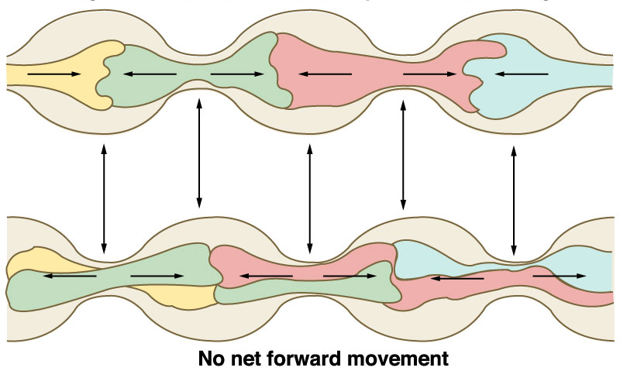
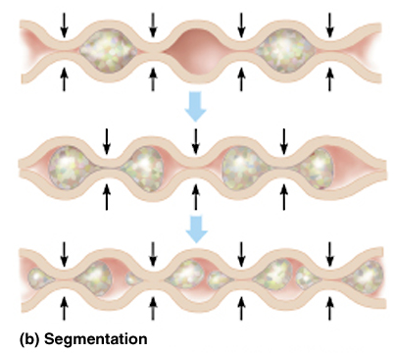
Segmentation: mix contents to promote digestion & absorption. It is myogenic i.e. controlled by the basic electric rhythm (BER).

Slide 42
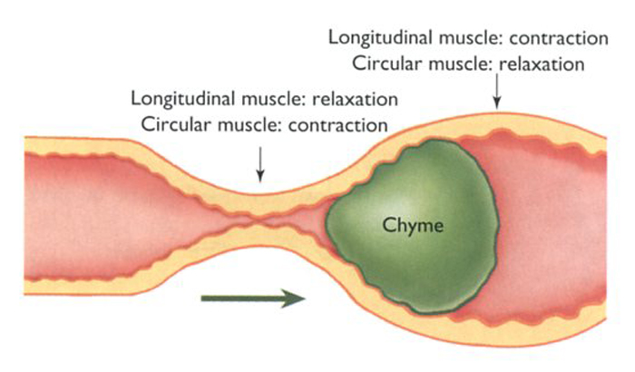

Slide 43
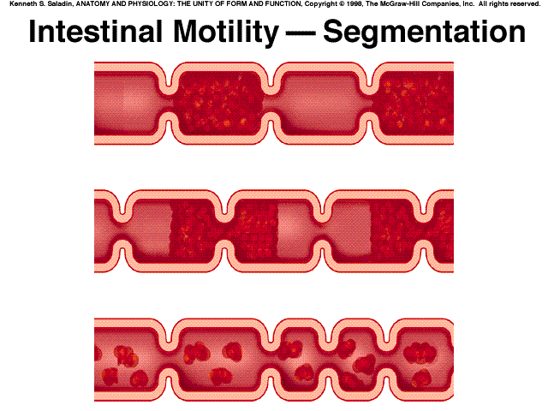
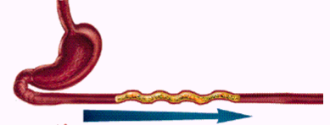
Intestinal Motility
serve three functions:
1) to mix chyme with intestinal juice, bile, and pancreatic juice (segmentation)
2) to churn chyme and bring it in contact with the brush border for digestion and absorption;
(segmentation)
3) to move residue toward the large intestine. (peristalsis)

Slide 44
Local intermittent constrictive contractions occur every few centimeters in the gut wall.
These constrictions usually last only 5 to 30 seconds;
New constrictions occur at other points in the gut, thus “chopping” and “shearing” the contents .

Slide 45
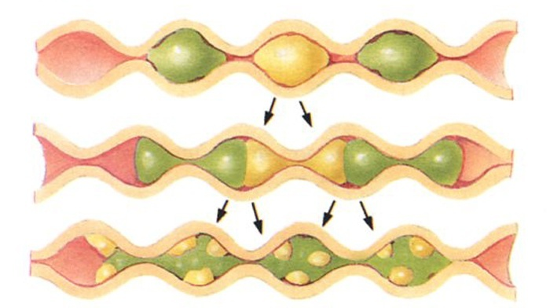
Mixing contraction of the Small Intestine. Rhythmic Segmentations Bring Through Mixing of the Intestinal Content

Slide 46
Appearance of a 'chain of sausages'.
As one set of segmentation contractions relaxes, a new set often begins, but the contractions this time occur mainly at new points between the previous contractions.
“chop” the chyme two to three times per minute-promoting progressive mixing of the food with secretions.

Slide 47
The maximum frequency of segmentation contractions in the small intestine is determined by the frequency of electrical slow waves in the intestinal wall, which is the basic electrical rhythm
Maximum frequency of the segmentation contractions is about 12 /mt under extreme conditions of stimulation.
In the terminal ileum, the maximum frequency is usually 8-9 contractions/mt

Slide 48
The segmentation contractions become exceedingly weak when the excitatory activity of the enteric nervous system is blocked by the drug atropine.

Slide 49
II.Propulsive Movements— Peristalsis
The basic propulsive movement of the gastrointestinal tract
A contractile ring appears around the gut and then moves forward.
Any material in front of the contractile ring is moved forward.

Slide 50
Stimulation at any point in the gut can cause a contractile ring to appear in the circular muscle, and this ring then spreads along the gut tube.
(Peristalsis also occurs in the bile ducts, glandular ducts, ureters, and many other smooth muscle tubes of the body.)

Slide 52
Stimuli for peristalsis
The usual stimulus for intestinal peristalsis is distention of the gut.
Stretching of the gut wall stimulates the enteric nervous system to contract the gut wall 2 - 3 centimeters behind this point, and a contractile ring appears that initiates a peristaltic movement.
Chemical or physical irritation of the epithelial lining in the gut.
Strong parasympathetic nervous signals to the gut will elicit strong peristalsis.

Slide 53
Peristalsis, theoretically, can occur in either direction from a stimulated point, but it normally dies out rapidly in the oral (toward the mouth) direction while continuing for a considerable distance toward the anus.
Myenteric plexus itself is “polarized” in the anal direction

Slide 54
Law of gut
Peristalsis normally begins on the oral side of the distended segment and moves towards the distended segment, pushing the intestinal contents in the anal direction .
Takes 5 to 10 centimeters before dying out.

Slide 55
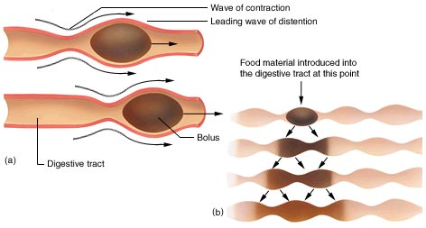
Peristalsis & sementation contraction of the small intestine
http://medweb.bham.ac.uk/research/toescu/Teaching/OverviewGITY2.html

Slide 56
Bolus of food →Mechanical distension and mucosal irritation → stimulates afferent enteric neurons → 2 effects
Excitatory motor neurons above the bolus activated → contraction of smooth muscle above the bolus
Via Ach, substance P
Inhibitory motor neurons → stimulate relaxation of smooth muscle below the bolus
Via nitric oxide, vasoactive intestinal peptide and ATP

Slide 57
Gut relaxes several centimeters downstream toward the anus, called “receptive relaxation,” thus allowing the food to be propelled more easily toward the anus than toward the mouth.
The complex is called the myenteric reflex or the peristaltic reflex.
The peristaltic reflex plus the anal direction of movement of the peristalsis is called the “law of the gut.”

Slide 58
These can occur in any part of the small intestine
Move toward the anus at a velocity of 0.5 to 2.0 cm/sec, faster in the proximal intestine
They are normally weak and usually die out after traveling only 3 to 5 centimeters, rarely farther than 10 centimeters,
so forward movement of the chyme is very slow,
Net movement along the small intestine normally averages only 1 cm/min.
3 to 5 hrs are required for passage of chyme from duodenum tothe end of small intestine

Slide 59
Peristaltic activity of the small intestine is greatly increased
After a meal- causing stretch of the duodenal wall.
Gastroenteric reflex - initiated by distention of the stomach and conducted principally through the myenteric plexus from the stomach down along the wall of the small intestine.
Hormons- Gastrin, CCK, Insulin, Motilin, Serotonin.
Conversely, secretin and glucagon inhibit small intestinal motility.

Slide 60
Peristaltic Rush.
Intense irritation of the intestinal mucosa, -severe cases of infectious diarrhea, can cause both powerful and rapid peristalsis
Initiated partly by nervous reflexes that involve the autonomic nervous system and brain stem and partly by intrinsic enhancement of the myenteric plexus reflexes within the gut wall itself.
The powerful peristaltic contractions travel long distances in the small intestine within minutes, sweeping the contents of the intestine into the colon and thereby relieving the small intestine of irritative chyme .

Slide 61
Migrating motor complex
MMC:
Occurs during fasting state
moves any undigested material still remaining in the small intestine into the large intestine
prevents bacteria from remaining in the small intestine long enough to grow and multiply excessively

Slide 62
Movements of Villi
The muscularis mucosae can cause short folds to appear in the intestinal mucosa.
Individual fibers from this muscle extend into the intestinal villi and cause them to contract intermittently.
The mucosal folds increase the surface area exposed to the chyme, thereby increasing absorption.
Contractions of the villi—shortening, elongating, and shortening again—“milk” the villi so that lymph flows freely from the central lacteals of the villi into the lymphatic system.
These mucosal and villous contractions are initiated mainly by local nervous reflexes in the submucosal nerve plexus that occur in response to chyme in the small intestine.

Slide 63
Movements of the Colon
The principal functions of the colon
Absorption of water and electrolytes from the chyme to form solid feces
Storage of fecal matter until it can be expelled.
Proximal half of the colon,is concerned principally with absorption, and the distal half with storage.
Movements of the colon are normally sluggish.

Slide 64
Mixing Movements—“Haustrations.
Segmentation movements -large circular constrictions occur in the large intestine.
At each of these constrictions, about 2.5 centimeters of the circular muscle contract,
The longitudinal muscle of the colon, which is aggregated into three longitudinal strips called teniae coli, contracts.
The combined contractions of the circular and longitudinal strips of muscle cause the unstimulated portion of the large intestine to bulge outward into baglike sacs called haustrations.

Slide 65
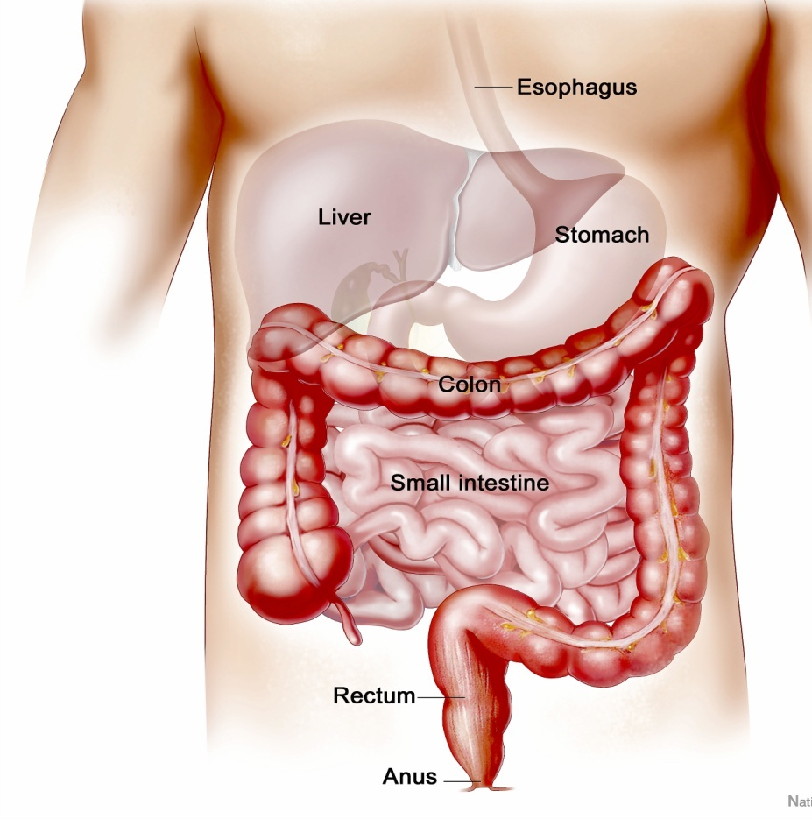
Mass peristalsis
1- gastrocolic reflex
2- duodenocolic reflex
3- gastroilial reflex

Slide 66
Each haustration usually reaches peak intensity in about 30 seconds and then disappears during the next 60 seconds.
They also at times move slowly toward the anus during contraction, especially in the cecum and ascending colon, and thereby provide a minor amount of forward propulsion of the colonic contents.
After another few minutes, new haustral contractions occur in other areas nearby.

Slide 67
Mass movement

Slide 68
propulsive/mass movement
Propulsion in the cecum and ascending colon results from the slow but persistent haustral contractions, requiring 8 to 15 hours to move the chyme from the ileocecal valve through the colon.
chyme itself becomes fecal in quality, a semisolid slush instead of semifluid.

Slide 69
From the cecum to the sigmoid, mass movements occur, for many minutes at a time, take over the propulsive role.
These movements usually occur only one to three times each day, especially for about 15 minutes during the first hour after eating breakfast.

Slide 70
Mass Movement

Slide 71
A mass movement is a modified type of peristalsis
First, a constrictive ring occurs in response to a distended or irritated point in the colon, usually in the transverse colon.
Then, rapidly, the 20 or more centimeters of colon distal to the constrictive ring lose their haustrations
Contract as a unit, propelling the fecal material in this segment en masse further down the colon.

Slide 72
The contraction develops progressively more force for about 30 seconds, and relaxation occurs during the next 2 to 3 minutes.
Then, another mass movement occurs, this time perhaps farther along the colon.
A series of mass movements usually persists for 10 to 30 minutes.
Then they cease but return perhaps a half day later. When they have forced a mass of feces into the rec_x0002_tum, the desire for defecation is felt.

Slide 73
Migrating motor complex (MMCs):
It is a fasting long peristalsis every 60-90 minutes from the stomach to the terminal ileum.
It sweeps any undigested food in preparation for the next meal & helps to prevents bacteria from remaining in the small intestine

Slide 74
Defecation
Defecation Reflex
initiated when rectal walls stretch
⇓
parasympathetic reflex
⇓
walls of the sigmoid colon and the rectum to contract & relaxation of the anal sphincter
⇓
External sphincter control is voluntary control
⇓
If defecation is delayed: the reflex stops until the next mass movement

Slide 75
References: https://www.youtube.com/watch?v=k3PGPmATFSA https://www.austincc.edu/apreview/EmphasisItems/GImotility.html
THANK YOU

